Slide 1
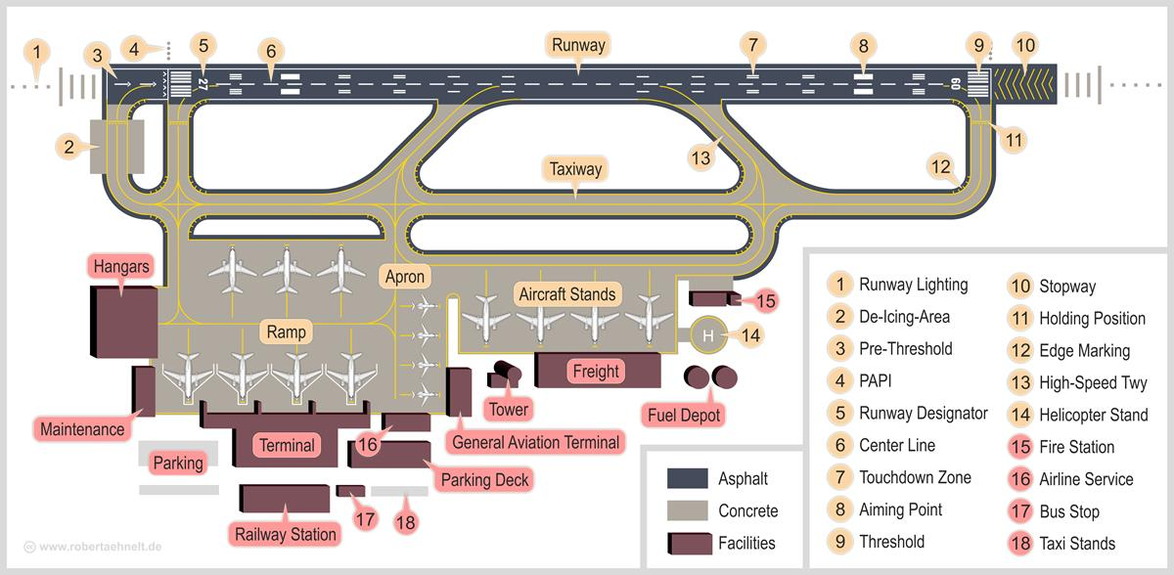
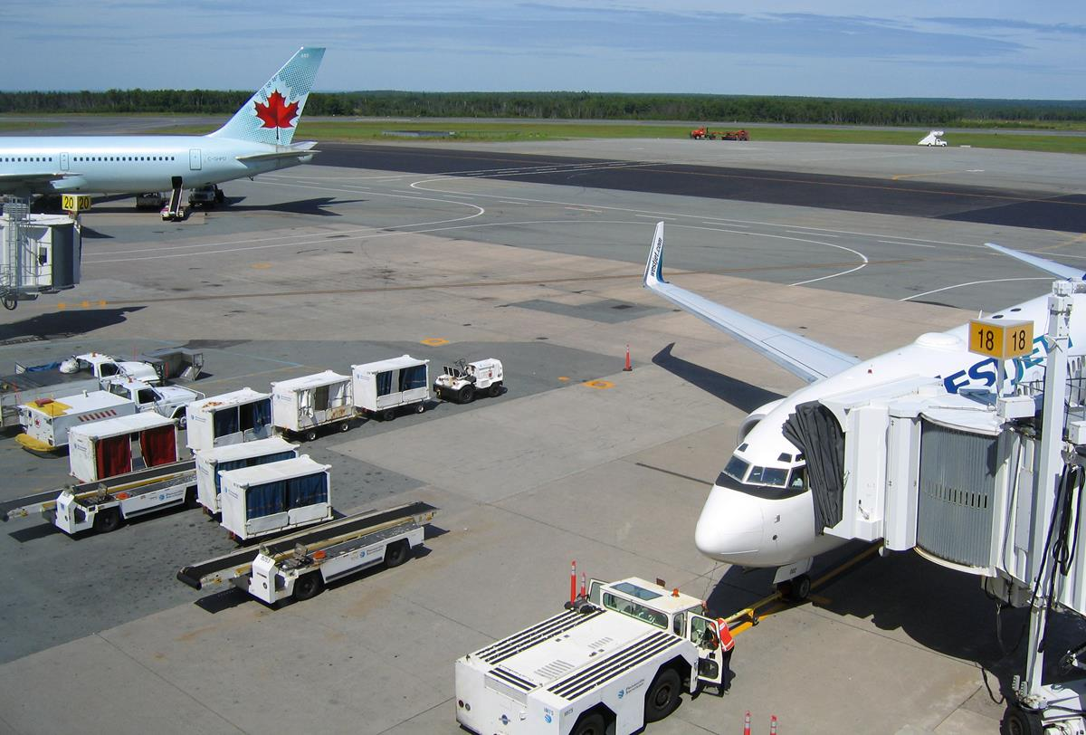
Airport DELAYS DURING GOVERNMENT SHUTDOWN
Team BAMF: LeAnne Sevier, Luciana Roberts, Lillian Bolfer, Mike Machata, Rob Phillips

Slide 2
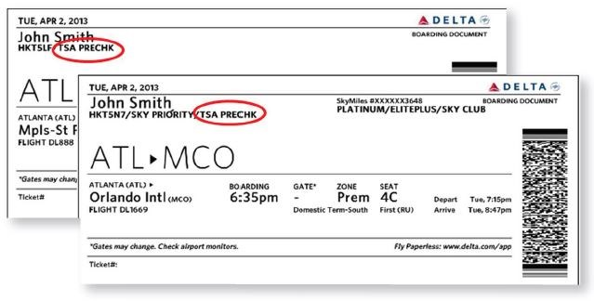
Contents
Hypothesis
A guide to air travel during the government shutdown
Asking the right questions
Finding relevant data
Data exploration and clean up
Analysis process
Findings and conclusions
Summary

Slide 3
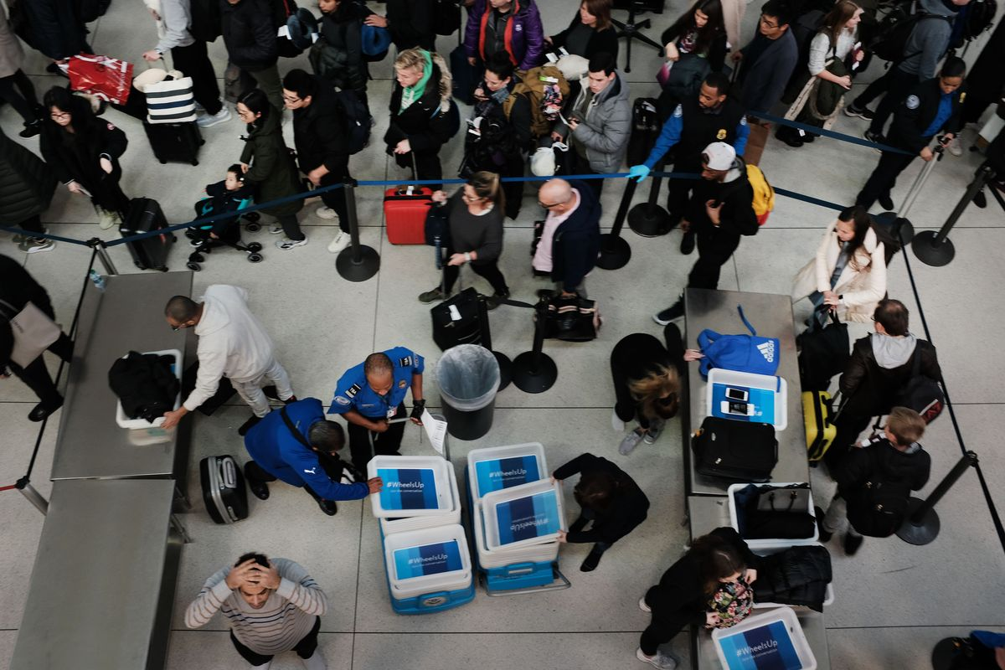
Hypothesis: The recent government shutdown during the period of December 22nd 2018 through January 25th 2019 impacted airlines and airport operations. What evidence is there that airports or airlines experienced significant delays? What can we learn from an analysis of data available on flight delays?
Government shutdown impacts U.S. airline industry
January 14, 2019 Henry Carmichael
Because of the now record-breaking partial government shutdown, the U.S. aviation industry is beginning to feel the consequences of lapsed federal funding.
"This partial shutdown has already inflicted real damage to our nation’s aviation system and the impacts will only worsen over time. We urge you to act quickly to resolve these issues.‘’
The letter highlights 11 major areas of concern affecting travel.
The greatest impact that the Federal Aviation Administration (FAA) is facing from the shutdown comes from a slowdown in hiring new workers. While the 25,000 air traffic controllers are exempt from furloughs, training for new controllers has been suspended, which may lead to a shortage of controllers. At the same time, airports have seen longer lines stemming from Transportation Safety Administration (TSA) workers calling in “sick” due to not being paid. The situation is powerful enough to impact the overall functionality of major U.S. airports. For example, Miami International’s (MIA) spokesman Greg Chin announced that one of its terminals would be partially closed over the weekend.
“Due to an increased number of TSA screeners not reporting to work, we decided to take this precautionary step and relocate about 12 flights to adjoining concourses in the afternoons,” said Chin, responding to concerns that not enough screeners would be available to manage MIA’s 11 checkpoints.
U.S. air carriers are also facing the impact of 4,000 FAA inspectors being furloughed by the shutdown. A proposed solution to aviation industry uncertainty that has been brought forward previously (and given new life by the shutdown) is to privatize the FAA. Lawmakers have suggested moving air traffic controllers out of federal authority to a non-for-profit entity that would be overseen by industry members. This would theoretically insulate the FAA from government inefficiencies and allow the agency to change with the economy.

Slide 4
A guide to air travel during the government shutdown
https://www.ajc.com/news/world/will-airports-affected-possible-partial-government-shutdown/wQRRXS5s5By3daQFnz12bN/
As the longest government shutdown in US history continues, Americans are restructuring their travel plans.
How is the shutdown affecting agents?
TSA agents make up 51,000 of the 420,000 federal employees who are deemed “essential,” and while they will be paid for their work eventually, they have no clue when exactly that day will come.
Are airport lines longer?
Short answer: maybe. Although it depends on the airport, many major hubs have reported longer lines. “While national average wait times are within normal TSA times of 30 minutes for standard lanes ... some airports experienced longer than usual wait times,” TSA said in a statement.
At Hartsfield-Jackson Atlanta on January 15, travelers waited more than an hour in security lines. And at Dallas Love Field Airport, travelers waited 44 minutes.
Are flights getting delayed or canceled?
Not yet. Flight delays may be caused by winter storms across the Midwest, but so far, the government shutdown has not led to widespread delays or cancellations. There is, however, potential for future delays because of air traffic controllers. Air traffic controllers are also essential employees, and therefore have also been working without paychecks. If they start calling in sick, the government may have to limit the amount of air traffic, but it hasn’t come to that yet

Slide 5
Potential implications for industry and the traveler
https://www.cnbc.com/2019/01/16/united-ceo-worried-about-shutdown-but-impact-not-yet-significant.html
United Airlines CEO Oscar Munoz on Wednesday said the airline is getting worried about the partial U.S. government shutdown as it drags on but added that the company isn't yet seeing a "significant" impact on bookings.
Munoz's comments come a day after the CEO of rival Delta Air Lines, Ed Bastian, said the shutdown that began Dec. 22 will cost the airline $25 million this month.
"There is some impact there," Munoz told CNBC's Phil LeBeau in an interview Wednesday. "It's not discernible and it's not significant. Clearly the longer this goes, of course there's going to be impact, and we do worry about that.“
On Tuesday, Delta's Bastian said the airline is losing $25 million in revenue this month alone because fewer government employees and contractors are traveling.
Transportation Security Administration officers, air traffic controllers and federal safety inspectors are among the some 420,000 government employees who are deemed essential and have been ordered to work without a regular paycheck.
Major airports in Atlanta, Miami, Houston and Washington, D.C., this week said they closed passenger screening lanes or checkpoints as more TSA officers than usual were absent.

Slide 6
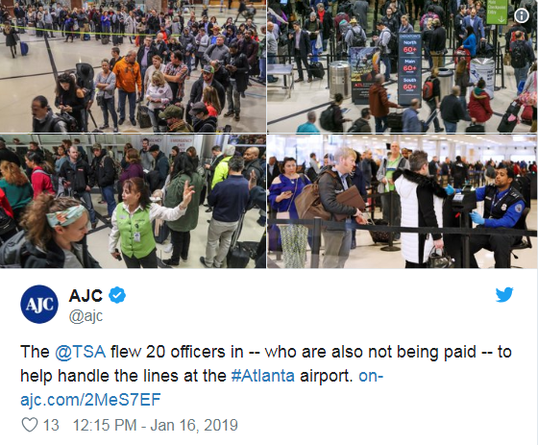
Shutdown effects build over time
Dec 26 - Holiday travel should not be impacted by the partial federal government shutdown - https://www.usatoday.com/story/news/politics/2018/12/26/government-shutdown-impact-your-holiday-travel-plans/2414075002/
Jan 8 - Air travelers start to feel effects of government shutdown - https://www.chicagotribune.com/news/nationworld/ct-tsa-airports-government-shutdown-20190108-story.html
Jan 15 - TSA experienced a national rate of 6.8 percent of unscheduled absences compared to a 2.5 percent rate one year ago on the same day - https://www.tsa.gov/news/releases/2019/01/15/tsa-statement-checkpoint-operations-january-15
Jan 16 - Several airports in the US have been forced to closed terminals due to a shortage of security workers following the partial shutdown of the US Federal Government. Airports affected include Miami International Airport in Florida and George Bush International Airport in Houston, Texas - https://www.airport-technology.com/news/us-government-shutdown-airport/
Jan 25 - 10 air traffic controllers called in sick, six in northern Virginia and four in Florida, temporarily shutting down travel at New York's La Guardia airport and causing delays at other major hubs, including in New Jersey, Philadelphia, Orlando and Atlanta - https://www.cnn.com/2019/01/25/us/air-traffic-controller-shortage-faa/index.html

Slide 7
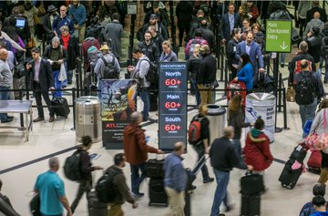
Asking the right questions
What data can we analyze to determine impacts on flights during the period of the government shutdown?
Cirium Flightstats API
https://helpdesk.cirium.com/hc/en-us/categories/202631018-FlightStats-by-Cirium
What are we looking for in the data specifically?
An increase in the number of flights delayed
An increase in the delayed departure times
How do we want to frame or scope the investigation?
Limit the analysis to one Airline (Delta Airlines)
Limit the analysis to two Airports (Major Hub Atlanta and Orlando)
Afternoon flights where delays might accumulate (2pm-8pm)
First and final weeks of the government shutdown period
What are we comparing this data to?
Data for the first and final weeks of the previous year
Date Range A: Dec 22 2017 – Jan 25 2018
Date Range B: Dec 22 2018 – Jan 25 2019

Slide 8
Assumptions/Omissions
Potential variables not considered:
Air Line issues: The number one cause of flight delays are factors within the air line’s control. Issues such as maintenance, crew and hiring, cleaning, fueling, and baggage loading.
Inclement weather. Major weather events such as tornados, snow storms, heavy rain, and fast winds make it unsafe for an airplane to take off.
Airport security issues. Acts of vandalism, terrorism, threats, and extended security screenings will cause major delays in flights
Heavy airport volume. Heavier than average volume in travelers can cause long lines for ticketing, TSA screening, and general operations. Months with major holidays such as December will have heavier airport traveler volume.
Late arriving aircraft. When a previous flight arrives late it has a ripple effect causing other departing flights to be delayed.
Airport staffing issues. Malperformance or absence of TSA, ticketing staff, and air traffic controllers may have contributed to delays.
The government shutdown started in December 2018. Due to the Christmas and New Year holidays, December has higher than average air travel volume which could contribute to the delays in this time period.
https://www.bts.gov/topics/airlines-and-airports/understanding-reporting-causes-flight-delays-and-cancellations

Slide 9
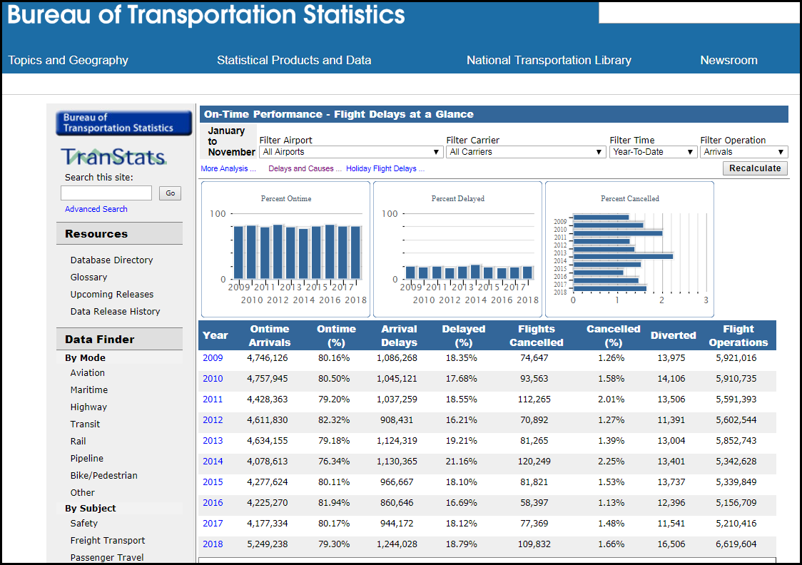
Finding Data
Bureau of Transportation Statistics – as part of the Department of Transportation, collects and provides statistics and analysis for commercial aviation, multimodal freight activity, and transportation economics
Has very detailed data that can be manipulated online for different data sets, as well as the ability to download detailed data
One noted consequence of the shutdown is delays to statistical analysis and reporting that is vital to most business sectors
We were unable to use this site as the last updates were only through November 2018

Slide 10

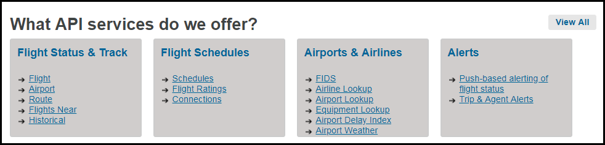
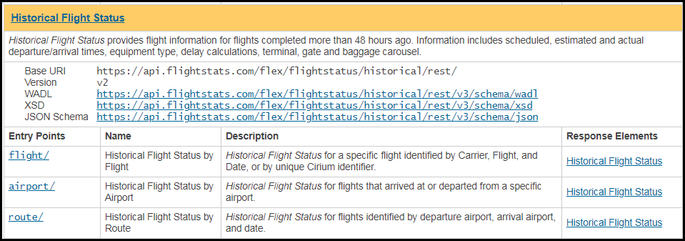
Finding Data
Cirium Flightstats Developer Center – a commercial provider of global flight data through analysis and API services
Access to real-time and historical information used by mobile developers, airports, travel agencies, airlines and more
BUYER BEWARE! Although easy to obtain and digest, the API services are not all free! Historical data is an example!
BUT, we were able to connect to the API to collect for the specific timeframes, airports, and airline we needed, extracting the data in JSON format

Slide 11
Finding relevant data
"flights": 84,
"observations": 83,
"canceled": 0,
"onTime": 59,
"delayed15": 4,
"delayed30": 4,
"delayed45": 16,
FLIGHT DELAY DATA – WHERE ART THOU?
Cirium’s API supports retrieval of current Flight Delay data at a specified airport
SOURCE: https://developer.flightstats.com/api-docs/delayindex/v1
JUPYTER: AirportDelays.ipynb OUTPUT: Delay_Request_MCO.txt
The flight delay response json provided some interesting metrics on flight delays (including bins)
however free access is limited to 100 current flights a month, so we had to use the Historical Flight Status API
Cirium’s Historical Flight Status API supports retrieval of Historical airport status (departures) by date, airport, airline, and time period (up to 6 hour block) – but there is a usage fee so we had to limit our data requests.
SOURCE: https://developer.flightstats.com/api-docs/historical-flight-status/v3
API DOC: https://developer.flightstats.com/api-docs/historical-flight-status/v3/historicalFlightStatusResponse#extendedOptions
JUPYTER: https://github.com/leannesevier/BAMF-Project-7/blob/master/Xtra%20Files/MCO9Read.ipynb
OUTPUT: https://github.com/leannesevier/BAMF-Project-7/blob/master/Xtra%20Files/Historic_Request_MCO_20190122_9.json
BINS !!!

Slide 12
Data exploration and cleanup #1
INCOMPLETE DATA!!!
Our first attempt at extracting “departureGateDelayMinutes” encountered some problems. The returned data did not always include a value for departureGateDelayMinutes, so we had to rely on ScheduledDeparture and ActualDeparture date and time to calculate the delay minutes using python.
JUPYTER: https://github.com/leannesevier/BAMF-Project-7/blob/master/FlightCounter.ipynb
The next challenge we encountered was that for very large data returns (specifically for Atlanta Airport), the json response was incomplete. Saving the json response to a text file revealed that the aircraft equipment strings of data were omitted from the end of the file. Fortunately no flight data was missing or corrupted. But when saving the text files with the extension ‘.json’, Visual Code also red underlined file content that was not json compliant. As such, our team then went about repairing the files, cleaning out non json content, and saving each text file as a json file: https://github.com/leannesevier/BAMF-Project-7/blob/master/Historic_Request_ATL_20171222_14.json

Slide 13
Data exploration and cleanup #2
ARE WE THERE YET?
The next challenge was not immediately apparent. While our team loaded each json file and quickly scanned through the hundreds of flights per day, some peculiarities arose. Whilst we included some python code to quickly calculate the delay time in minutes, a small number of flights appeared to have extremely early departures. This was actually due to evening flights delaying through to the next day. So rather than extracting and comparing the hour and minutes for the scheduled and actual flights, we commented this code out, and utilized the time and datetime modules to correctly compare the scheduled versus actual.
JUPYTER: https://github.com/leannesevier/BAMF-Project-7/blob/master/FlightCounter_v2.ipynb
IT’S ABOUT TIME !
With the date and time comparison corrected, we then went ahead and created a for loop for each airport, and a for loop for each date in the date range, so we now have a pandas dataframe for each Date Range (A and B).
JUPYTER: https://github.com/leannesevier/BAMF-Project-7/blob/master/FlightCounter_DateRangeA.ipynb
JUPYTER: https://github.com/leannesevier/BAMF-Project-7/blob/master/FlightCounter_DateRangeB.ipynb

Slide 14
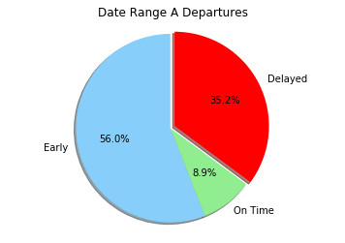
Analysis process – At a glance!
Flight Counter: 1
Airline Flight#: DL656
Airport: ATL
Date: 2017-12-22
Scheduled Departure: 2017-12-22T10:55:00.000 Actual Departure: 2017-12-22T16:51:00.000 Flight Departure Delayed by (H:M:S): 5:56:00 Departure Time Delta (minutes): 356.0
Delay
count | 2307.000000
mean | 7.107932
std | 32.141492
min | -28.000000
25% | -3.000000
50% | -1.000000
75% | 6.000000
max | 759.000000
Flight Counter: 2307
Airline Flight#: DL2601
Airport: MCO
Date: 2018-01-25
Scheduled Departure: 2018-01-25T19:56:00.000 Actual Departure: 2018-01-25T19:50:00.000 Flight Departed Early by (H:M:S): 0:06:00 Departure Time Delta (minutes): -6.0
Total Departures: 2307
 | Early | On Time | Delayed
0 | 1291 | 205 | 811

Slide 15
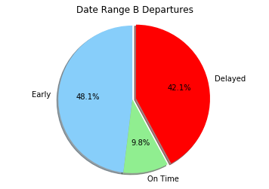
Analysis process – At a glance!
Flight Counter: 1
Airline Flight#: DL365
Airport: ATL
Date: 2018-12-22
Scheduled Departure: 2018-12-22T12:20:00.000 Actual Departure: 2018-12-22T16:37:00.000 Flight Departure Delayed by (H:M:S): 4:17:00 Departure Time Delta (minutes): 257.0
Delay
count | 2312.000000
mean | 12.047578
std | 41.850855
min | -16.000000
25% | -3.000000
50% | 0.000000
75% | 10.000000
max | 656.000000
Flight Counter: 2312
Airline Flight#: DL1060
Airport: MCO
Date: 2019-01-25
Scheduled Departure: 2019-01-25T19:59:00.000 Actual Departure: 2019-01-25T20:33:00.000 Flight Departure Delayed by (H:M:S): 0:34:00 Departure Time Delta (minutes): 34.0
Total Departures: 2312
 | Early | On Time | Delayed
0 | 1111 | 227 | 974

Slide 16
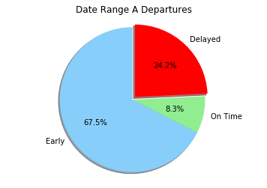
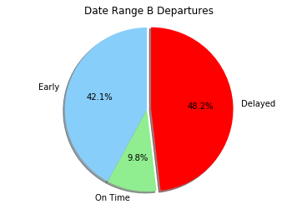
So what’s the diff? Look at the Final Weeks
Delay
count | 1295.000000
mean | 2.808494
std | 31.247634
min | -28.000000
25% | -4.000000
50% | -2.000000
75% | 0.000000
max | 759.000000
Delay
count | 1300.000000
mean | 17.196154
std | 51.856415
min | -14.000000
25% | -2.000000
50% | 0.000000
75% | 15.000000
max | 656.000000
Early | On Time | Delayed | Total
874 | 107 | 314 | 1295
Early | On Time | Delayed | Total
547 | 127 | 626 | 1300
JUPYTER
JUPYTER

Slide 17
Initial Findings
FIRST FACTS
There is a subtle increase in the number of flights comparing Date Range B to Date Range A. According to publications on Atlanta and Orlando airports, there has been a gradual increase of passengers over this period in the order of about 3%, and about 1.6% of flights. In the same reports, Delta Airlines is identified as constituting approximately 70% of all flights.
SOURCE: https://www.atl.com/wp-content/uploads/2018/12/ATL-Traffic-Report-Nov-2018.pdf
SOURCE: https://www.orlandoairports.net/press/2018/09/18/passenger-traffic-numbers-continued-record-pace-in-july-at-orlando-international-airport/
There is approximately a 7% increase in the number of flights delayed between the two date ranges, but insufficient information to suggest that this is due to the government shutdown. This is complex because there are several variables which may or may not contribute to this increase. Publications list several factors that may be contributors.
There is however, a significant increase in the number of flights delayed when comparing the final weeks of both date ranges. In fact, the final week of the government shutdown period exhibits double the number of delayed flights compared with the same week of the previous year. This definitely requires deeper investigation.

Slide 18
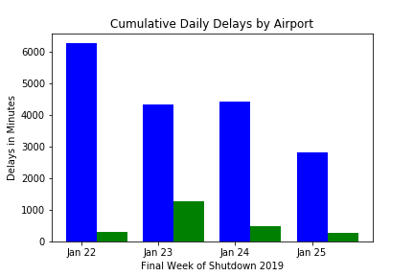
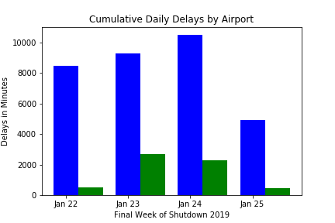
Initial Findings

Slide 19
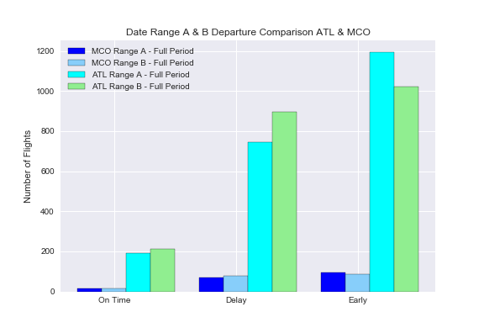
Findings and conclusions
In the date range A, MCO airport has handled less than 8.5 % of the Delta flights comparing with the numbers of Delta flights in ATL airport. Even that MCO airport shows a higher proportional number of delayed departure flights.
In the shutdown period (range B) this difference has increased, showing that even operating a much higher number of flights, Atlanta airport has had a smaller impact with the shutdown than Orlando airport, when it comes to flight departures delays.

Slide 20
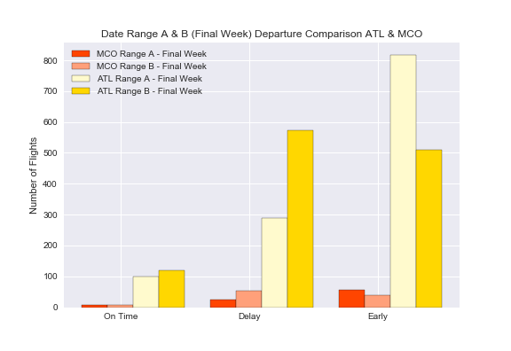
Findings and conclusions
In the last week of the shutdown the number of
delayed departure flights has increased, representing over half of total delays for full shutdown period. (MCO full period 79, 52 in the last week – ATL full period 895, 574 in the last week) The increase might be related with TSA sickouts reaching 10% on Jan 20, 2019.
https://www.forbes.com/sites/michaelgoldstein/2019/01/22/us-airlines-take-stock-market-hit-as-government-shutdown-reaches-32-days/#68ff706a79de

Slide 21
Findings and conclusions
ATL & MCO Passengers Number
PASSENGERS | JAN 2019 | JAN 2018 | DEC 2018 | DEC 2017
Atlanta Total | 8,064,004 | 7,708,129 | 8,642,487 | 8,062,075
Total Delta Passengers | 5,906,095 73,24% of total | 5,658,463 73,52% of total | 6,282,965 72,70 % of total | 5,775,565 71.64% of total
Orlando Total | 4,117,402 | 3,905,568 | 4,315,895 | 3,982,171
https://www.atl.com/business-information/statistics/
https://orlandoairports.net/about-us/#traffic-statistics

Slide 22
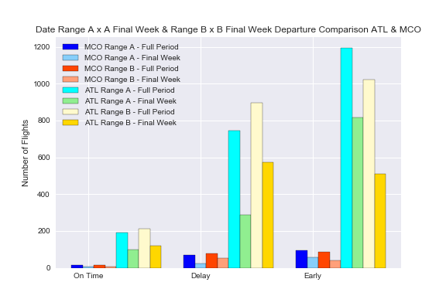
Findings and conclusions
Comparing the numbers of flights in each date range per airport, we can conclude that MCO airport has being more affected by the shutdown in number of flights departure delays, than Atlanta airport, however, in the subject “delays” historically MCO airport has been behind ATL airport .
The MCO average delays for customs/security is 24,45 min. against 12,27 in ATL airport.
The average departures delays in MCO is 68 min. against 58 in ATL.
Atlanta Airport has a Delay Index of B – (401,78) and MCO Delay Index is D (517,80).
Based on these numbers we can assume that ATL airport was better prepared to deal with the shutdown than MCO airport.
https://www.orlandoweekly.com/Blogs/archives/2018/11/21/orlando-international-airport-ranked-among-most-likely-to-delay-your-flight

Slide 23
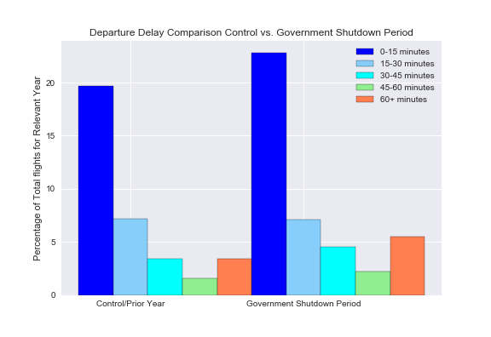
Findings and conclusions

Slide 24
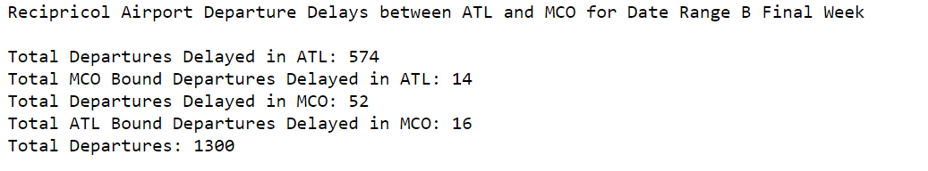
Findings and conclusions
AIRPORT TO AIRPORT IMPACT ANALYSIS
Q: What evidence is there that delays at one airport cause delays at another airport?
Based on the data we collected, we decided to examine any possible causality of delay from MCO to ATL and vice versa.
According to our data queries, only 4.8% (14+16) /( 574+52) of delayed flights out of ATL and MCO were bound for the other airport. This implies that on average, delays incurred at one airport do not incur significant delays at the other airports. But each airport has a different volume of airline flights originating from other airports (both domestic and international).
While Atlanta only received a comparative 2.8% of its delayed flights from MCO, Orlando received a comparative 27% of its delayed flights from ATL. So what does the data reveal for each airport?

Slide 25
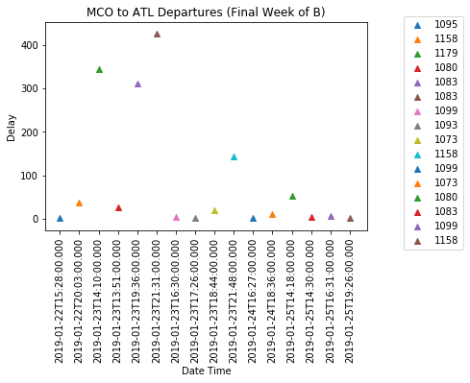
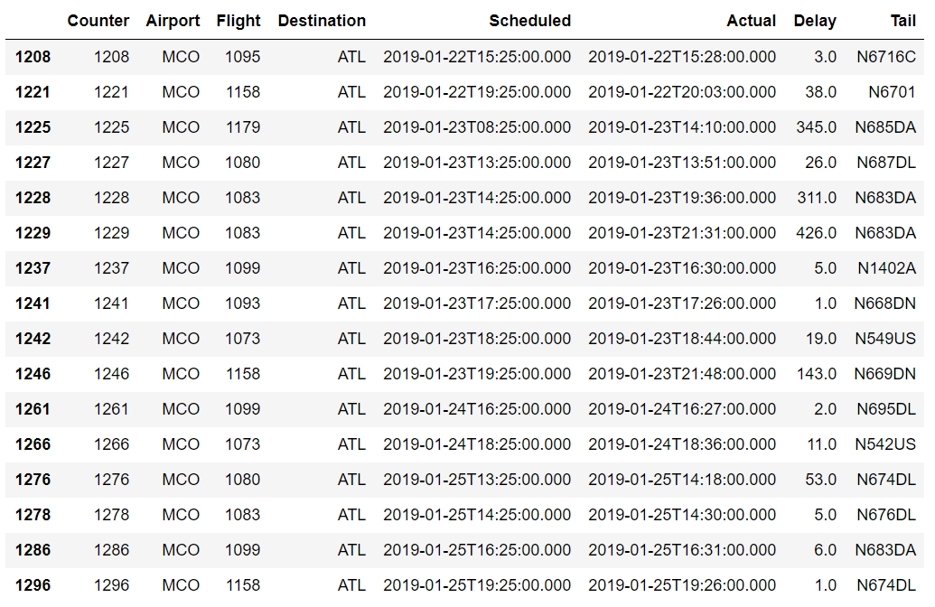
Findings and conclusions
ORLANDO AIRPORT: The most significant ATL bound flight delays occurred on January 23rd where all but two of the eight delayed flights greatly exceeded mean delay durations of 12 (Range B) and 17 minutes (Range B Final Week).
JUPYTER
Flight 1083 / N683DA appeared to have particular difficulties with accumulative delays.

Slide 26
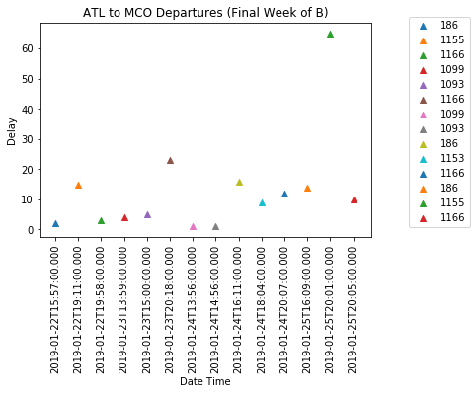
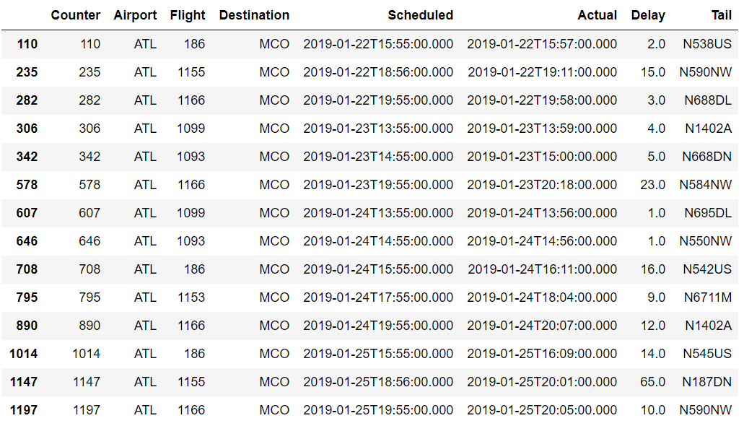
Findings and conclusions
ATLANTA AIRPORT: Considering ATL is a major hub (particularly for Delta Airlines), the mean delay for MCO bound aircraft is less than 15 minutes, which almost all fall within typical delay durations. While the 65 minute delay is outside our 8pm limit.
Based on the unique tail numbers, it appears that Delta utilizes a reserve of aircraft at ATL to operationally optimize for earliest possible departures.
JUPYTER

Slide 27
Summary
Watch Out! Data Analysts Beware! – Some API vendors charge by transaction (10 cents per flight)
Government shutdown effects on airports and airlines is gradual. There was no significant disruption to the number of flights or passengers, and delay durations in the first week of shutdown was comparable to the non government shutdown period.
Delta Airlines appears to be able to operationally optimize aircraft at the Major Hub of Atlanta to reduce departures delay times. They are less dependent on specific aircraft making timely connections. But this does not imply that all passengers are always able to make their connections through Atlanta Airport.
Delayed flights bound for Atlanta from Orlando experience significantly larger delays compared with connections in Atlanta. This might be due to lower availability of air traffic controllers at MCO compared with ATL. It may also be due to the volume of passengers originating in Orlando, unable to board timely, due to extensive security checkpoint delays.
If the government elects to privatize air traffic controllers and airport security and customs officers, this might possibly alleviate some of the airport based flight delays. But there is insufficient data available to directly correlate all of these factors.
If I do need to travel during a government shutdown in the future, I would plan to book a morning flight from Orlando, with enough time to make an afternoon connection in Atlanta. I would be less concerned with my connection being delayed in Atlanta.

Slide 28
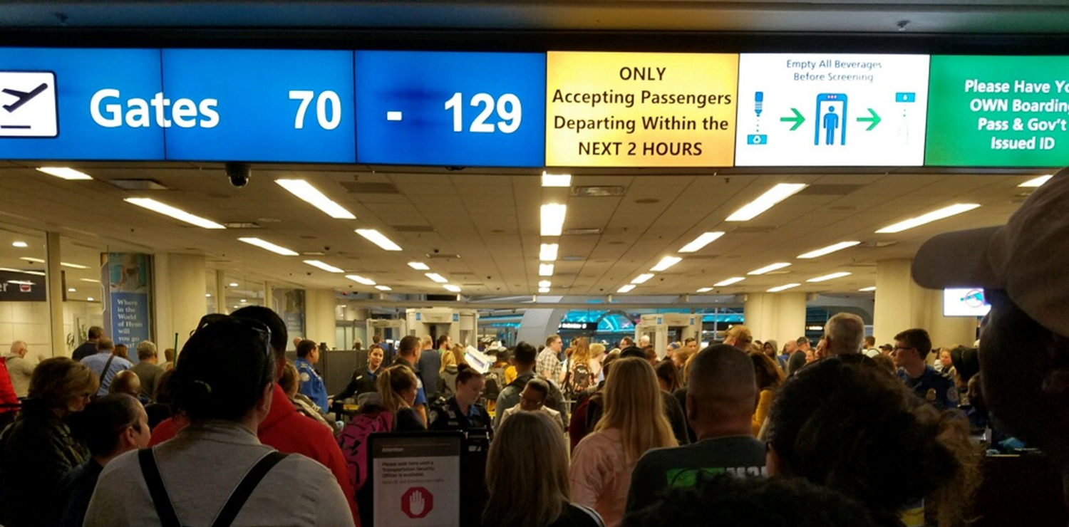
Enjoy Your Flight

